Slide 1


Titolo presentazione sottotitolo
CNOEC PROJECT
Gabriele Ribolla Enrico Tranquillini
Matteo Constantini
Milano, XX mese 20XX

Slide 2
Team
Enrico Tranquillini
B.S.: Automation Engineering (Polimi)
M.Sc: Automation and Control Engineering (Polimi)
Matteo Costantini
B.S: Automation Engineering (Unibo)
M.Sc: Automation and Control Engineering (Polimi)
Gabriele Ribolla
B.S.: Industrial Automation (UniBS)
M.Sc: Automation and Control engineering (PoliMi)

Slide 3
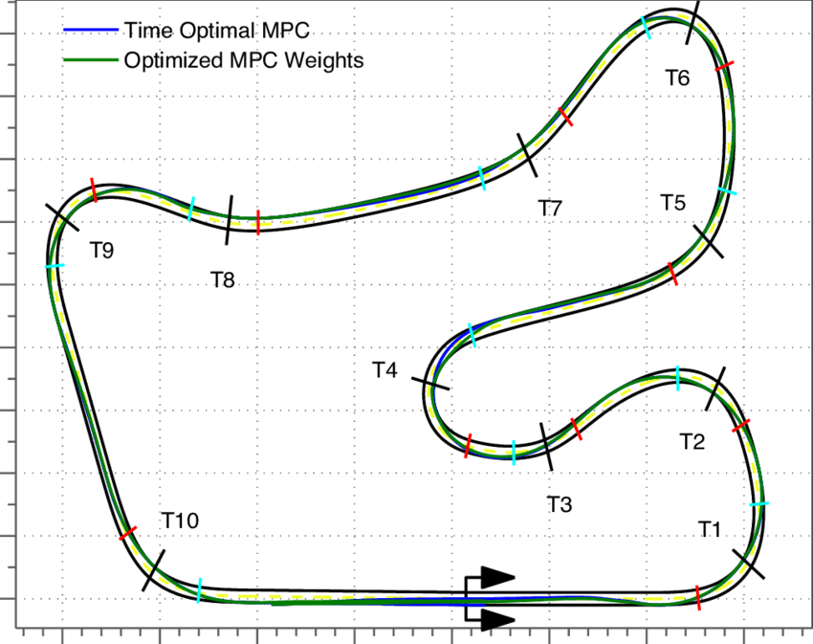
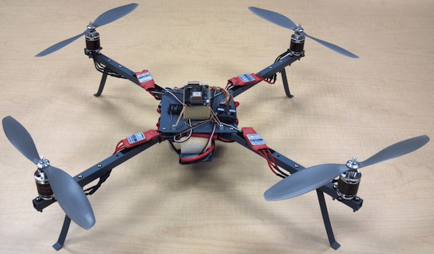
Project : qualitative goal
Goal: route optimization along a track using a drone.

Slide 4
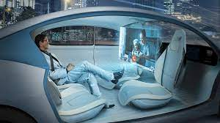
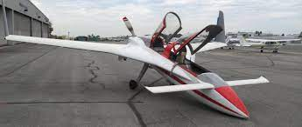
Project : reason why we chose the specific topic
Passions and interests about autonomous vechicles and Flight

Slide 5
Procedure to define the lap time
Steps
1:
define the optimal trajectory
using :
optimal trajectory function
2:
compute the speed profile and lap time
using :
speed profile function aware of constraints
3:
use nonlinear quadmotor model to compute final control inputs

Slide 6
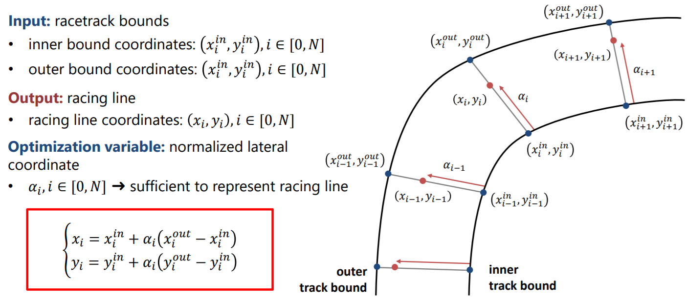
1° step : Main cost function and Contraints

Slide 7
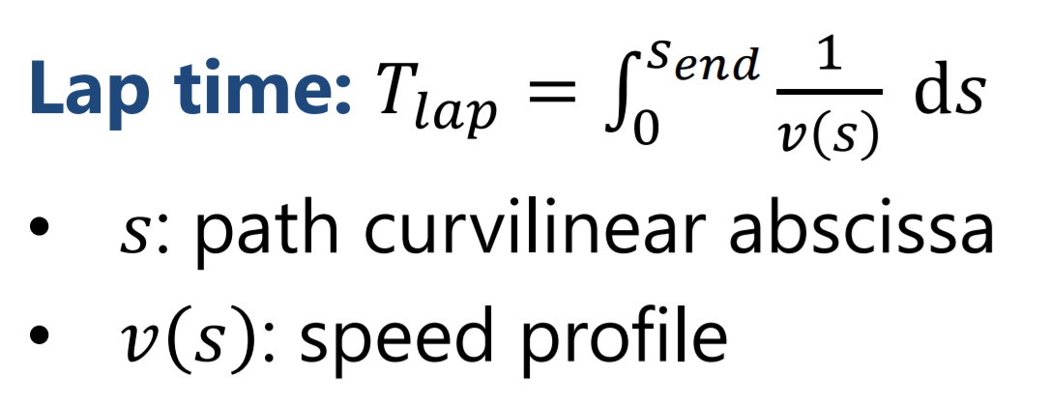
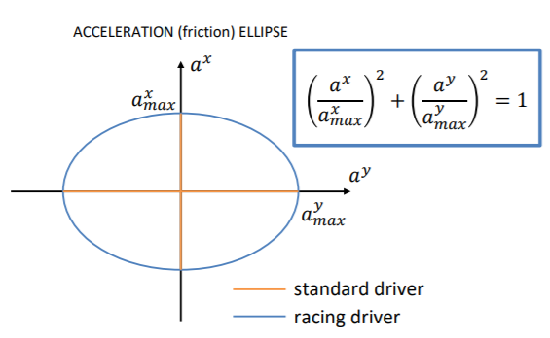
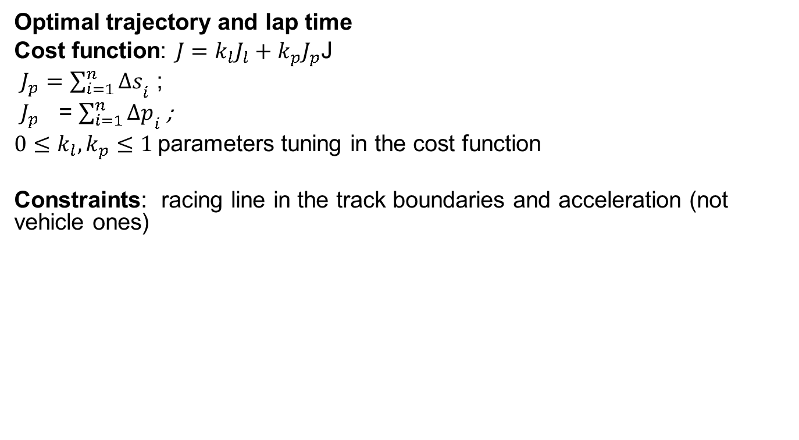
Project : the main cost functions and contraints
Optimal trajectory and lap time
Cost function: $J=k_{l}J_{l}+k_{p}J_{p}$J
$J_{p}={\sum_{i=1}^{n}{Δs}}_{i}$ ;
$J_{p}$ = ${\sum_{i=1}^{n}{Δp}}_{i}$;
$0≤k_{l},k_{p}≤1$parameters tuning in the cost function
Constraints: racing line in the track boundaries and acceleration (not vehicle ones)

Slide 8
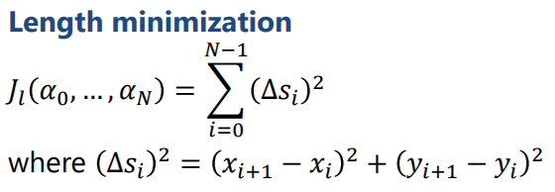
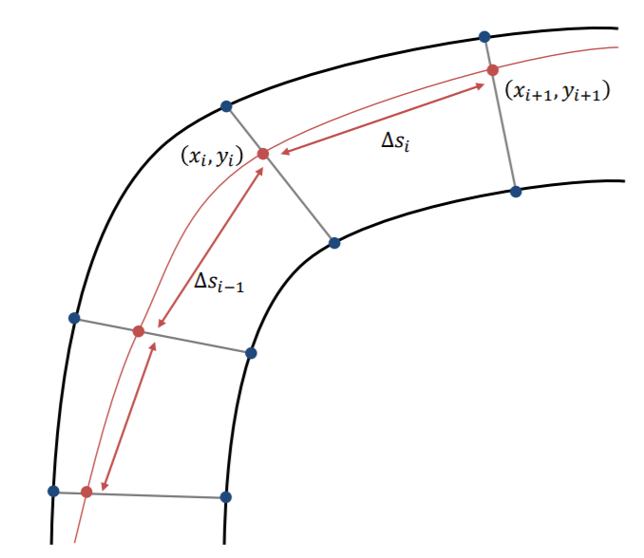
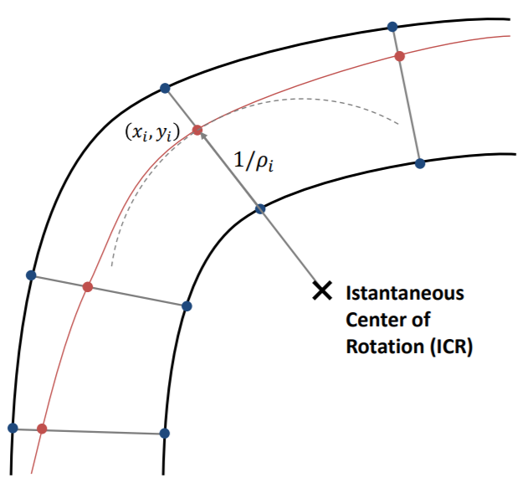
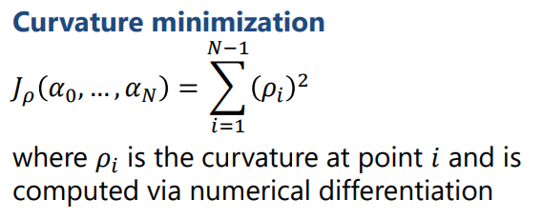
Cost Function

Slide 9
Quadcopter model

Slide 10
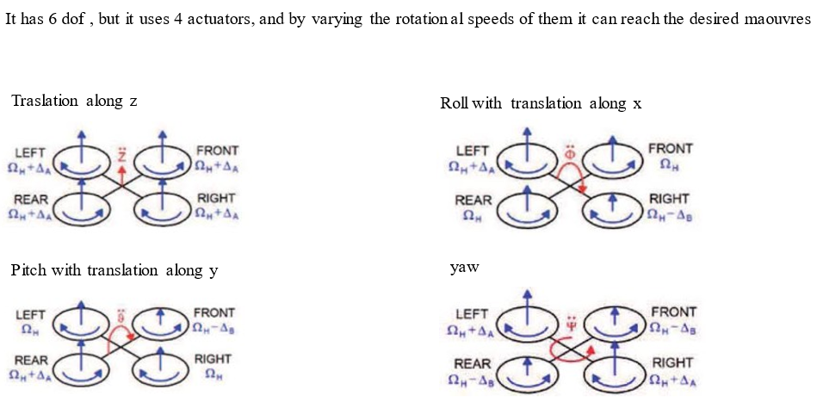
Flight physics

Slide 11
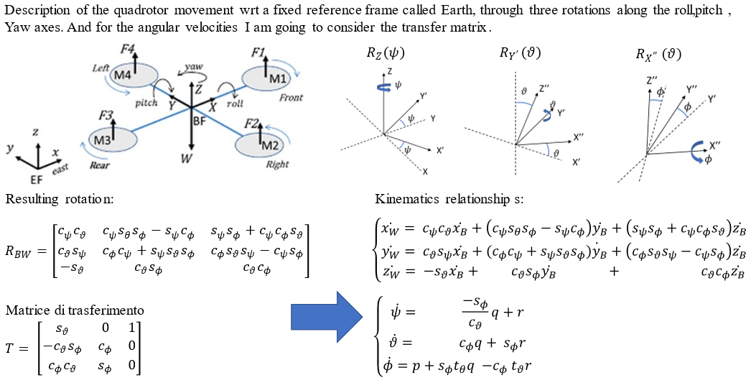
Kinematics of the system

Slide 12
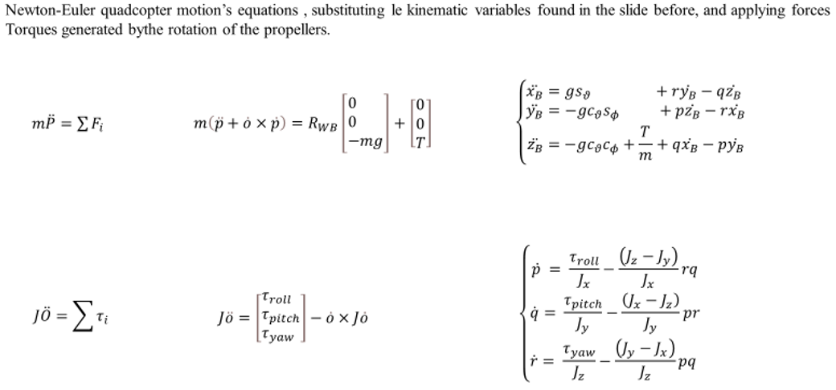
Dynamics of the system

Slide 13
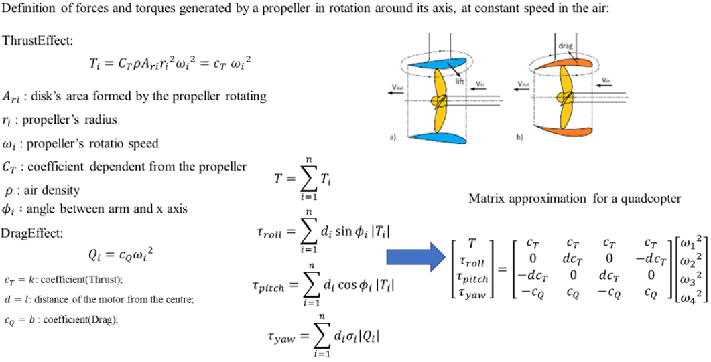
Aerodynamics of the propellers and definition of the inputs

Slide 14
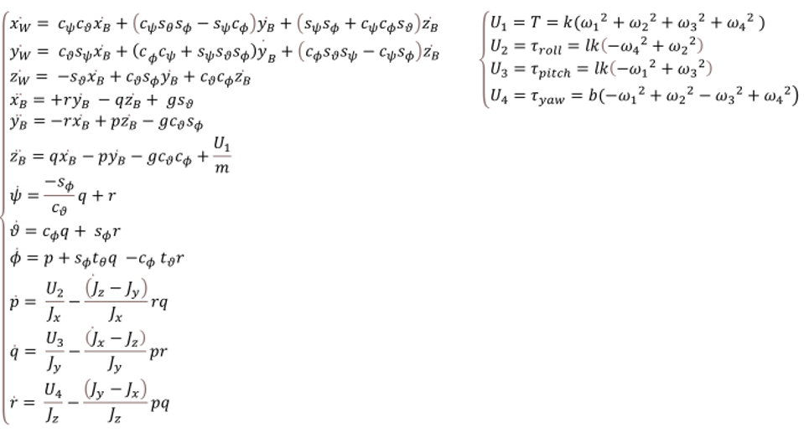
Non linear mathematical model

Slide 15
Modelization
function [zdot]=quadcopter(t,z,u,th)
%% Read parameters, states and inputs
% Parameters
mass = th(1,1);
Jx = th(2,1);
Jy = th(3,1);
Jz = th(4,1);
g = th(5,1);
% States
X = z(1,1); % inertial X position (m)
Y = z(2,1); % inertial Y position (m)
Z = z(3,1); % inertial Z position (m)
xbdot = z(4,1); % body x velocity (m/s)
ybdot = z(5,1); % body y velocity (m/s)
zbdot = z(6,1); % body z velocity (m/s)

Slide 16
Modelization
psi = z(7,1); % yaw angle (rad)
theta = z(8,1); % pitch angle (rad)
phi = z(9,1); % roll angle (rad)
p = z(10,1); % inertial p rate (rad/s)
q = z(11,1); % inertial q rate (rad/s)
r = z(12,1); % inertial r rate (rad/s)
% Inputs
T = u(1,1); % thrust force (N)
tauroll = u(2,1); % roll torque (N*m)
taupitch = u(3,1); % pitch torque (N*m)
tauyaw = u(4,1); % yaw torque (N*m)
%semplifications
cp=cos(psi);
sp=sin(psi);
ct=cos(theta);
st=sin(theta);
cf=cos(phi);
sf=sin(phi);

Slide 17
Modelization
%% Model equations
zdot(1,1) = cp*ct*xbdot+(cp*st*sf-sp*cf)*ybdot+(sp*sf+cp*cf*st)*zbdot;
zdot(2,1) = ct*sp*xbdot+(cf*cp+sp*st*sf)*ybdot+(cf*st*sp-cp*sf)*zbdot;
zdot(3,1) = -st*xbdot+ct*sf*ybdot+ct*cf*zbdot;
zdot(4,1) = r*ybdot-q*zbdot+g*st;
zdot(5,1) = -r*xbdot+p*zbdot-g*ct*sf;
zdot(6,1) = q*xbdot-p*ybdot-g*ct*cf+T/mass;
zdot(7,1) = -(sf/ct)*q+r;
zdot(8,1) = cf*q+sf*r;
zdot(9,1) = p+(sf*st/ct)*q-(cf*st/ct)*r;
zdot(10,1) = (tauroll/Jx)-((Jz-Jy)/Jx)*r*q;
zdot(11,1) = (taupitch/Jy)-((Jx-Jz)/Jy)*r*p;
zdot(12,1) = (tauyaw/Jz)-((Jy-Jx)/Jz)*p*q;

Slide 18
Simulation
%% Model parameters
Jx=0.0058319;
Jy=0.0058319;
Jz=0.0111886;
I_drone = [ ...
Jx, 0, 0;
0, Jy, 0;
0, 0, Jz;
] ; % (kg.m^2)
mass = 0.9272;%(kg)
g=9.81;
Tmax=45;%(N)
taurollmax=0;%(Nm)
taupitchmax=0.58;
tauyawmin=-0.58;
th = [mass;Jx;Jy;Jz;g];

Slide 19
Simulation
%% Simulation: Initial state
Vb_init = [0;0;0]; % (m/sec) initial velocity in BODY axes
wb_init = [0;0;0]; % (rad/sec) initial body rates
eul_init = [0;0;0]; % (rad) initial euler angles (yaw,pitch,roll)
Xe_init = [0;0;0]; % (m) initial position in inertial axes
%state vector INITIAL conditions
q_init = [ Xe_init;
Vb_init;
eul_init;
wb_init];
%% Simulation with ode45
% Time integration parameters
Ts_o45 = 1e-1; % sampling time (s)
Tend_o45 = 200; % final time (s)
tvec_o45 = 0:Ts_o45:Tend_o45; % time vector (s)

Slide 20
Simulation
% Initialize simulation output
N_o45 = length(tvec_o45); % number of samples
zout_o45 = zeros(12,N_o45); % matrix with states
uout_o45 = zeros(4,N_o45); % matrix with inputs
zout_o45(:,1) = q_init;
uout_o45(:,1) = [1+mass*g;1;1;1];
% Run simulation
for ind=2:N_o45
zout_temp = ode45(@(t,z)quadcopter(t,z,uout_o45(:,ind-1),th),[0 Ts_o45],zout_o45(:,ind-1));
zout_o45(:,ind) = zout_temp.y(:,end);
uout_o45(:,ind) = uout_o45(:,1);
end

Slide 21
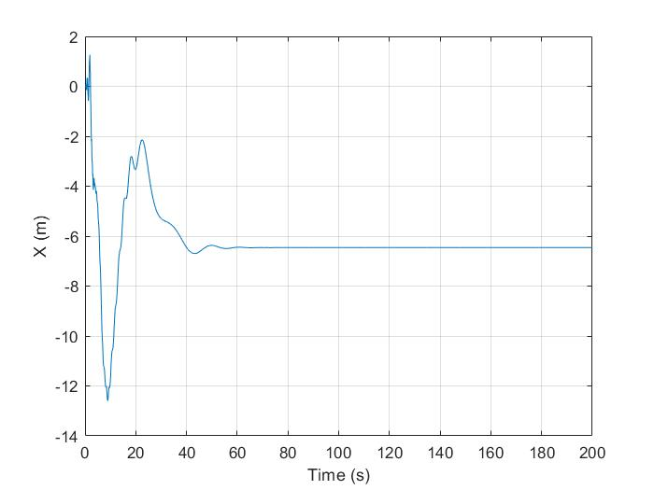
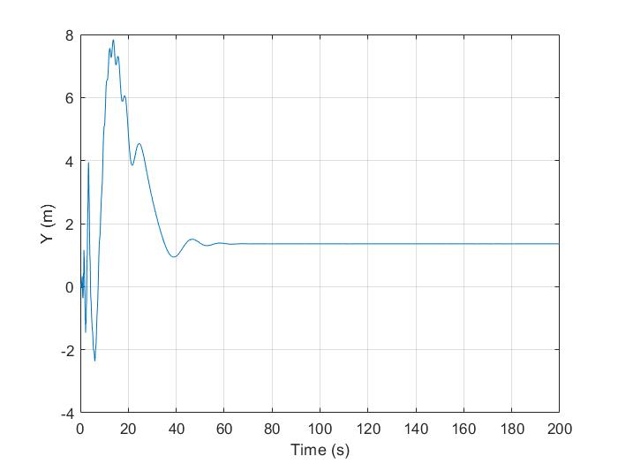
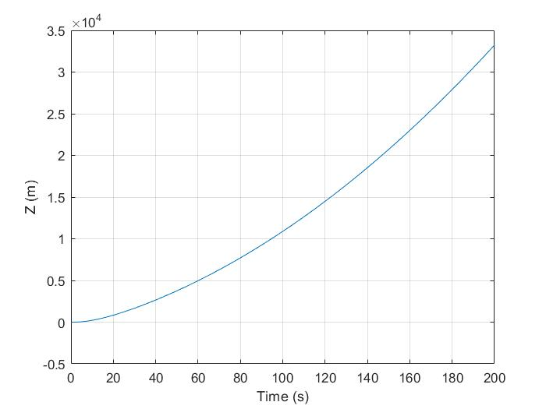
Results

Slide 22
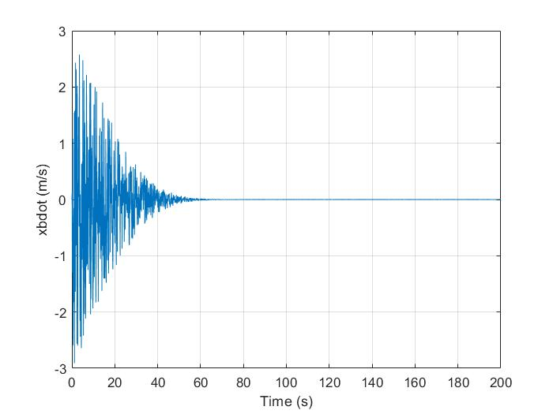
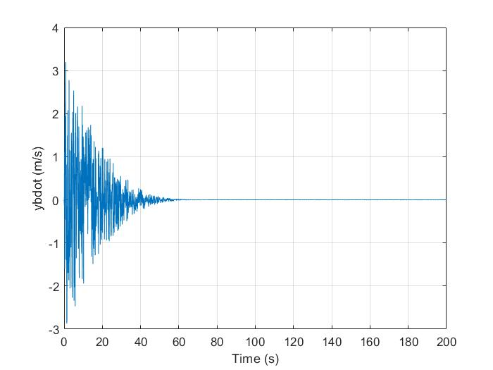
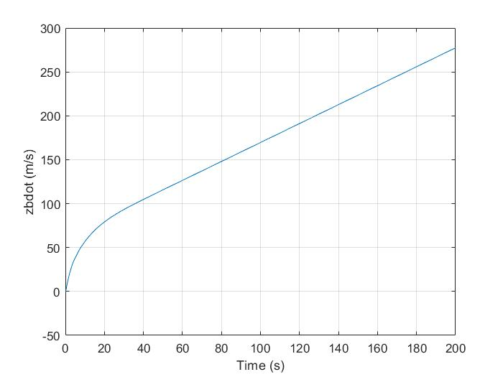
Results

Slide 23
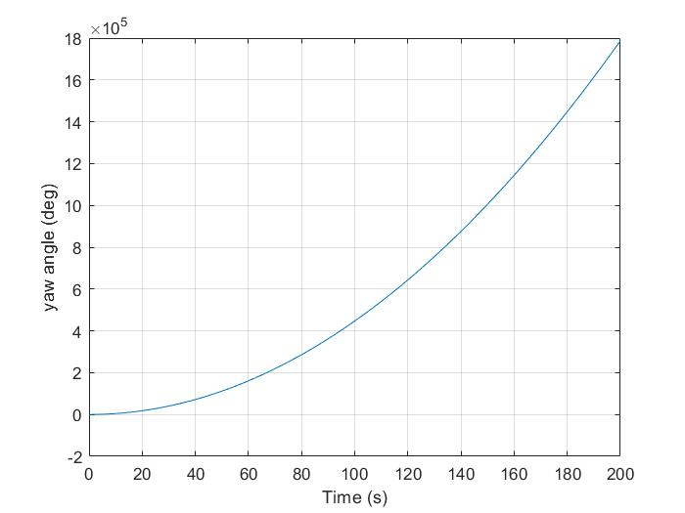
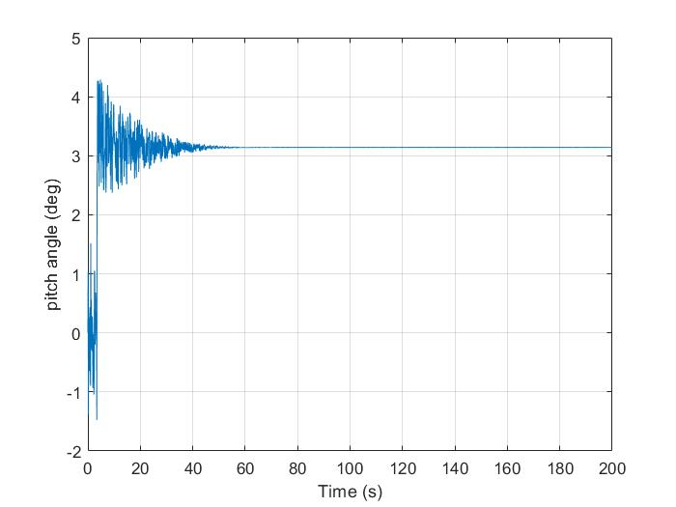
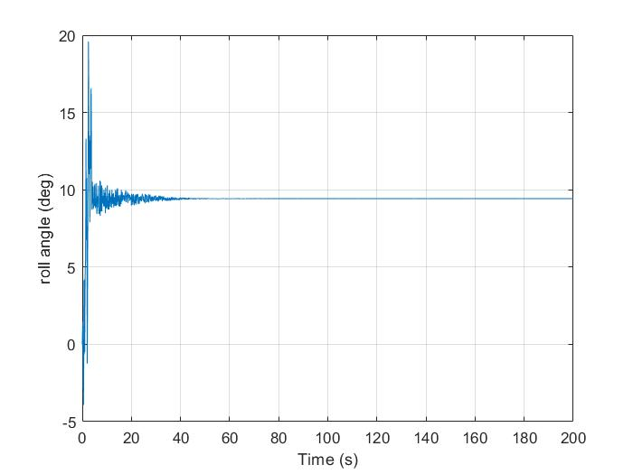
Results

Slide 24
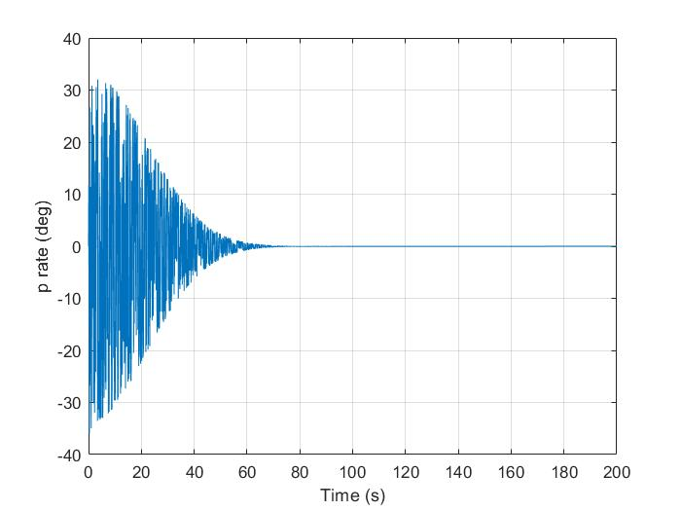
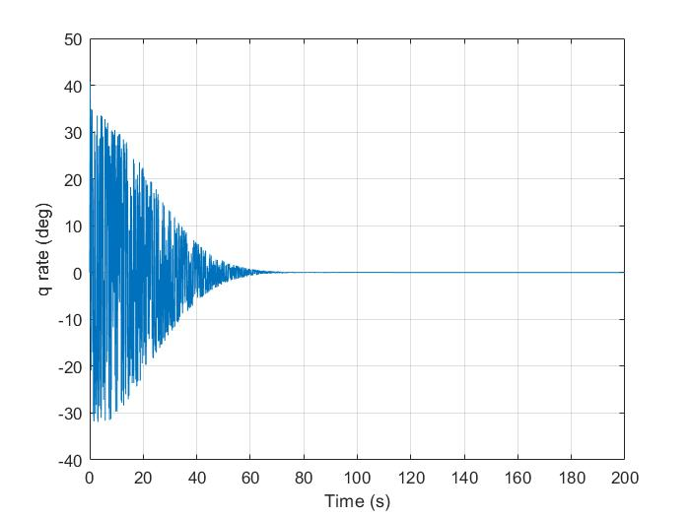
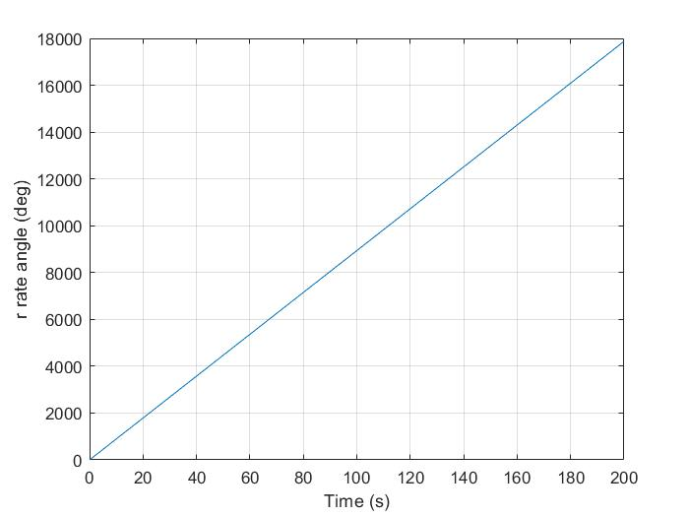
Results

Slide 25
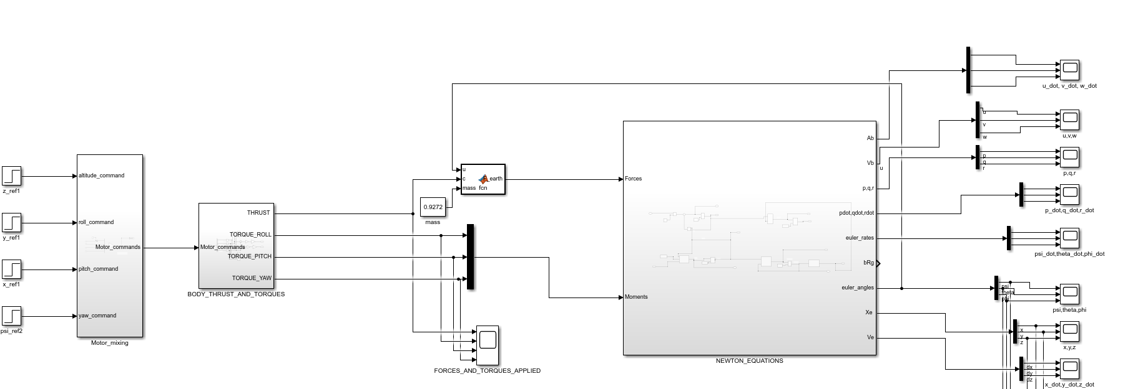
Simulation of the nonlinear model (Simulink)
The simulation of the uncontrolled non linear model takes as inputs some references of altitude,roll,pitch,yaw commands and plots the states of the system

Slide 26
Project : Plan
Complete:
3/12/2021: unconstrained optimization model
22/12/2021: integration with quadcopter model

Slide 27
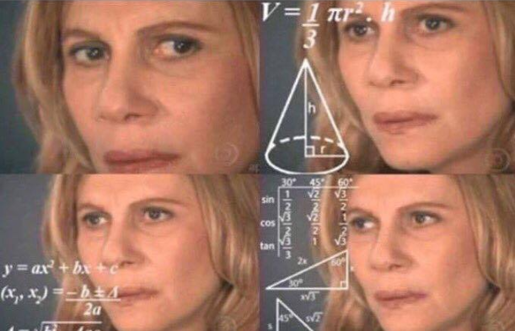
Questions??

Slide 28
Thanks for the attention

